Slide 1
Proof of Theorem 3.2
Reduction: Steiner Tree → Metric Steiner Tree
Vazirani — Approximation Algorithms, Chapter 3
Example: V = {a, b, c, d}, R = {a, c, d} (Required), Steiner = {b}
Edges: a-b(3), b-c(2), b-d(4), a-c(7), c-d(8)
📖 Vazirani: “Proof: We will transform, in polynomial time, an instance I of the Steiner tree problem, consisting of graph G = (V, E), to an instance I′ of the metric Steiner tree problem as follows.”

Slide 2
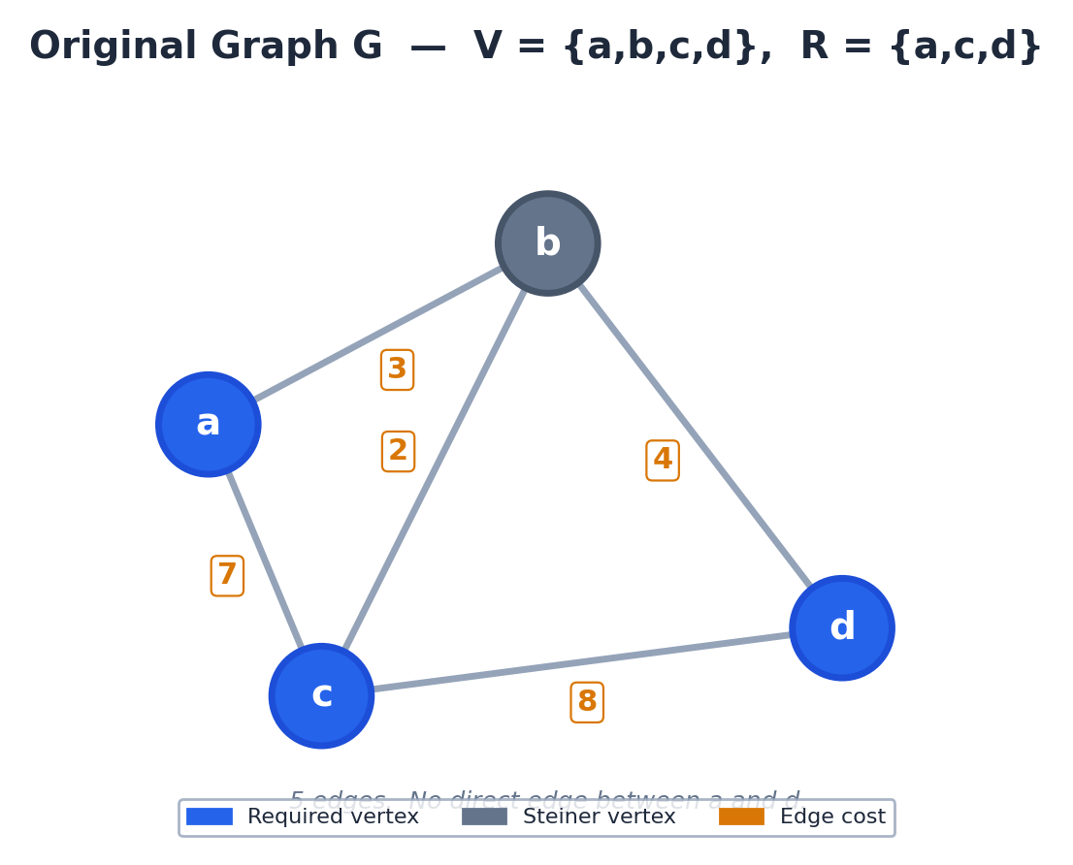
Slide 1 / 7 — Instance I: Graph G = (V, E)
V = {a, b, c, d} Required R = {a, c, d} Steiner = {b}
📖 Vazirani: “We will transform, in polynomial time, an instance I of the Steiner tree problem, consisting of graph G = (V, E), to an instance I′ of the metric Steiner tree problem as follows.”

Slide 3
Slide 2 / 7 — Construction: Shortest Path for Every Pair
Let G' be the complete graph on V. cost'(u,v) = shortest u-v path in G.
Pair (a, b)
Pair (a, c)
Pair (a, d)
• Direct a-b: 3
• Via c: 7+2 = 9
• Direct a-c: 7
• Via b: 3+2 = 5
• No direct edge
• Via b: 3+4 = 7
⟹ cost'(a,b) = 3
⟹ cost'(a,c) = 5 ⭐
⟹ cost'(a,d) = 7 (new!)
Pair (b, c)
Pair (b, d)
Pair (c, d)
• Direct b-c: 2
• Via a: 3+7 = 10
• Direct b-d: 4
• Via c: 2+8 = 10
• Direct c-d: 8
• Via b: 2+4 = 6
⟹ cost'(b,c) = 2
⟹ cost'(b,d) = 4
⟹ cost'(c,d) = 6 ⭐
📖 Vazirani: “Let G′ be the complete undirected graph on vertex set V. Define the cost of edge (u, v) in G′ to be the cost of a shortest u–v path in G.”

Slide 4
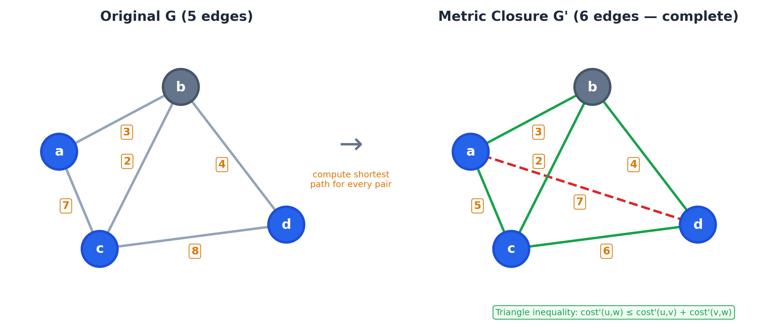
Slide 3 / 7 — Metric Closure G' (Complete Graph)
G' has C(4,2)=6 edges. cost'(u,v)=dist_G(u,v). R'=R={a,c,d}.
📖 Vazirani: “G′ is called the metric closure of G. The partition of V into required and Steiner vertices in I′ is the same as in I.”

Slide 5
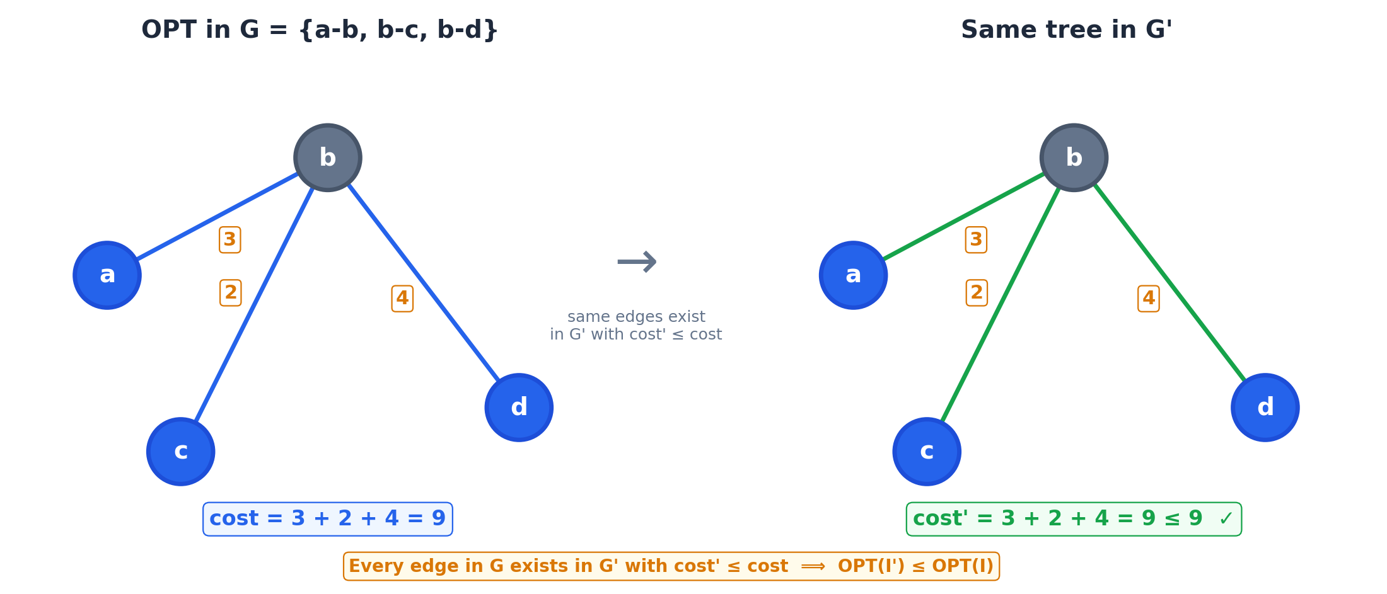
Slide 4 / 7 — Direction 1: OPT(I') ≤ OPT(I)
For any edge (u,v) ∈ E, cost in G' ≤ cost in G ⟹ OPT(I') ≤ OPT(I).
📖 Vazirani: “For any edge (u, v) ∈ E, its cost in G′ is no more than its cost in G. Therefore, the cost of an optimal solution in I′ does not exceed the cost of an optimal solution in I.”

Slide 6
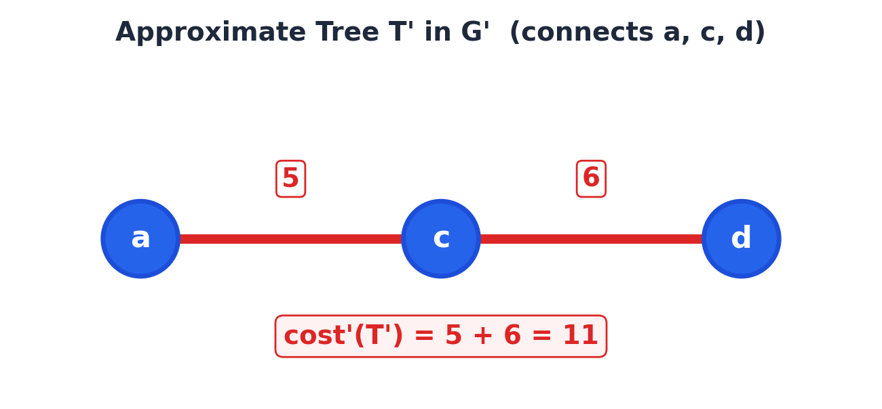
Slide 5 / 7 — Direction 2, Step A: Approx Tree T' in G'
Suppose an α-approximation gives T' = {a-c, c-d} in G'.
cost'(T') = 5 + 6 = 11 (connects all required vertices a, c, d)
📖 Vazirani: “Next, given a Steiner tree T′ in I′, we will show how to obtain, in polynomial time, a Steiner tree T in I of at most the same cost.”

Slide 7
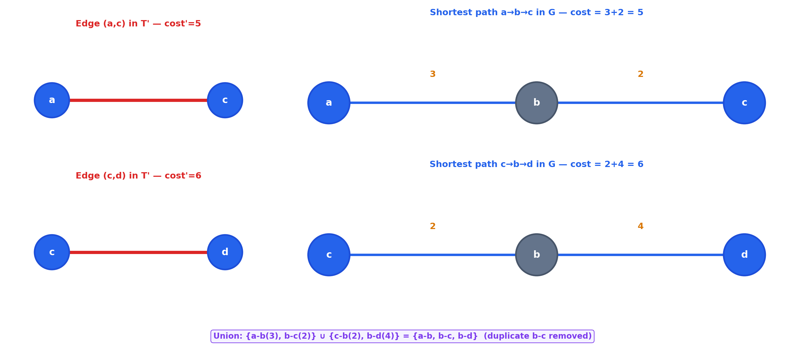
Slide 6 / 7 — Step B: Replace Edges by Shortest Paths
Replace each edge of T' by its corresponding shortest path in G:
📖 Vazirani: “The cost of an edge (u, v) in G′ corresponds to the cost of a path in G. Replace each edge of T′ by the corresponding path to obtain a subgraph of G.”

Slide 8
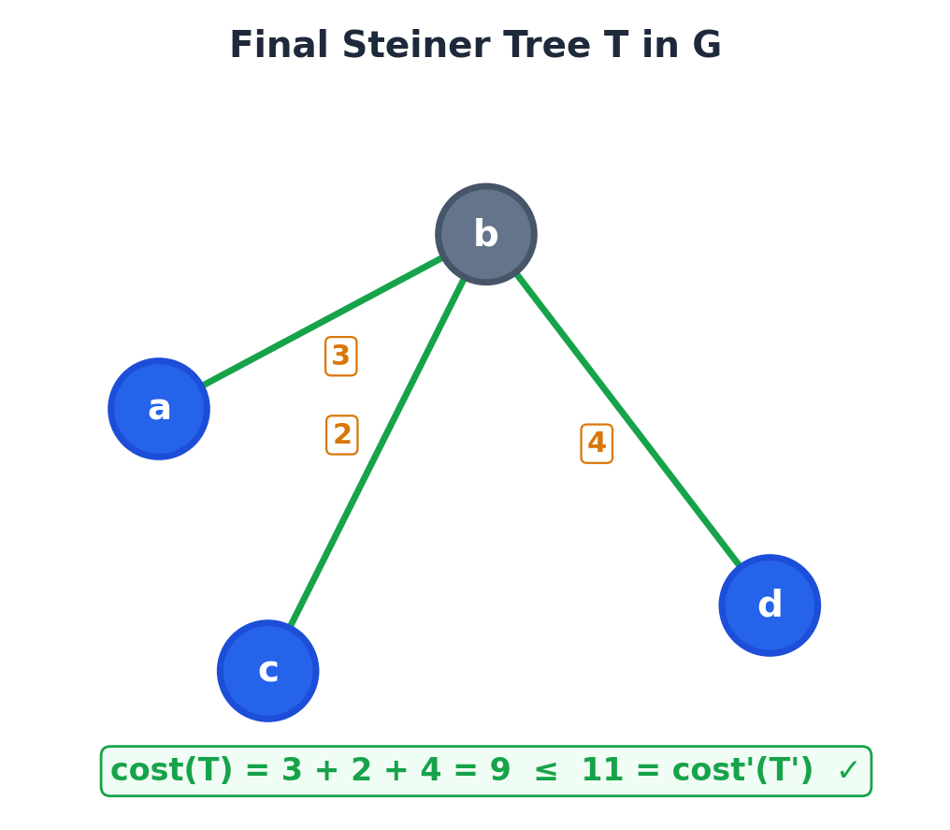
Slide 7 / 7 — Step C: Final Steiner Tree T in G
After removing duplicates, the subgraph is already a tree.
T = {a-b(3), b-c(2), b-d(4)} cost(T) = 3 + 2 + 4 = 9 ≤ 11 = cost'(T') ✓
📖 Vazirani: “Clearly, in this subgraph, all the required vertices are connected. However, this subgraph may, in general, contain cycles. If so, remove edges to obtain tree T.”

Slide 9
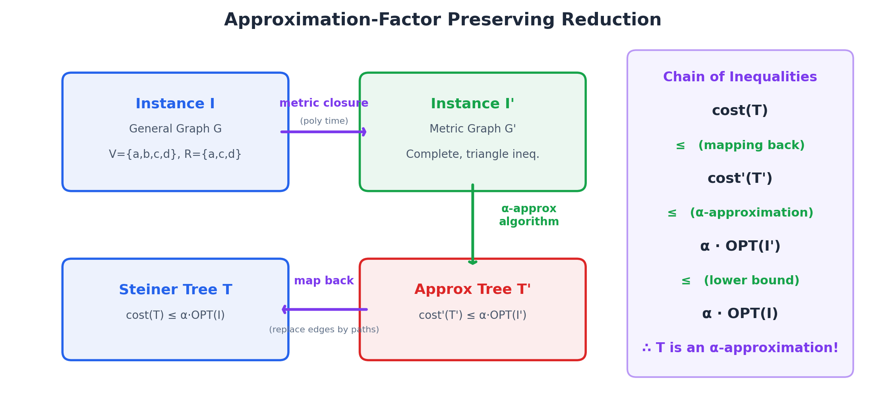
Conclusion — Factor-Preserving Reduction
📖 Vazirani: “This completes the approximation factor preserving reduction.”

Slide 10
Theorem 3.2 — Numerical Verification
Numerical Verification
OPT(I) in G:
tree {a-b(3), b-c(2), b-d(4)}, cost = 9
OPT(I') in G':
same tree with cost' = 9 ≤ 9 ✓
Approx T' in G':
{a-c(5), c-d(6)}, cost' = 11
Map back T in G:
{a-b, b-c, b-d}, cost = 9 ≤ 11 ✓
Theorem 3.2
The reduction from the Steiner tree problem
to the metric Steiner tree problem is
approximation factor preserving.
Chain of Inequalities:
cost(T)
≤ cost'(T') (mapping back)
≤ α · OPT(I') (α-approximation)
≤ α · OPT(I) (lower bound)
∴ T is an α-approximation for I
9 ≤ 11 ≤ α · 9 ≤ α · 9
■
📖 Vazirani: “As a consequence of Theorem 3.2, any approximation factor established for the metric Steiner tree problem carries over to the entire Steiner tree problem.”

